Slide 1
Vali IT

Slide 2
Ülesanded
BankController
1.1) createAccount
1.2) getAccount
1.3) depositMoney
1.4) withdrawMoney
1.5) transferMoney
2) Code in game (vaata readmest)

Slide 3
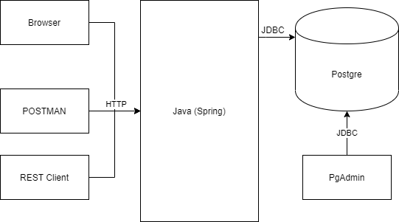
Architecture

Slide 4
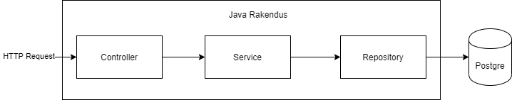
3-tier Architecutre

Slide 5
Controller
Annotated wih @Controller or @RestController
Use @GetMapping, @PutMapping, … to define endpoints
Inject service into controller (using @Autowired or constructor injection)

Slide 6
Service
Annotated wih @Service
Inject Repository class
Write business logic here (everything that is not database call or endpoint definition)

Slide 7
Repository
Annotated wih @Repository
Inject NamedParameterJdbcTemplate
Write all database queries here (SQL)

